Slide 1
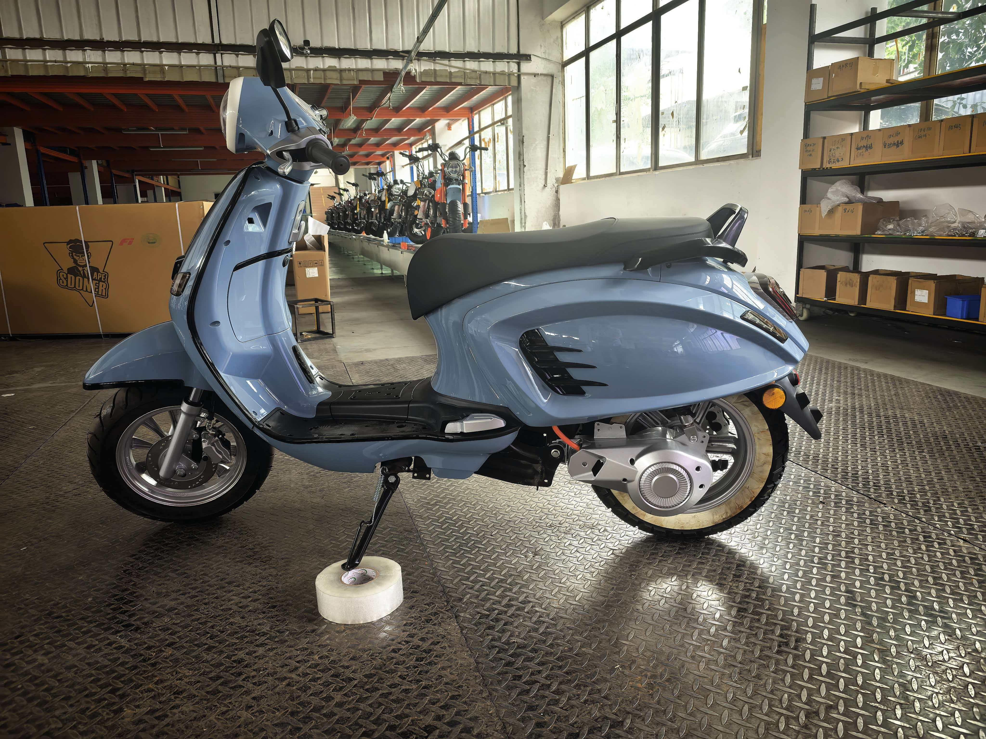

GPS · leasing · organisation fleets
HM AI Monitor
Eyes on every financed vehicle.
GPS + AI + work, from Dorkbouakham in Vientiane. Use our trackers, yours, a phone, or an HM EV that ships already online.
HM · Dorkbouakham · GPS + EV + HM AI Monitor · reference prices in LAK

Slide 2
About us
Dorkbouakham Trading Import-Export Co., Ltd
ບໍລິສັດ ດອກບົວຄຳ ການຄ້າຂາເຂົ້າ-ຂາອອກ ຈຳກັດ
Vientiane company in GPS fleet software, EV import and IoT. We operate HM AI Monitor, HM Todo, HM EVs and HM Franchise — one OS for enterprise assets in Lao PDR.
· HM AI Monitor + HM Todo — live map, AI drafts, close-out
· HM EVs — ready now: EV motorcycle + low-speed EV; later own-brand HM, GPS-ready
· Lao platforms — trackerla.laoapps.com · monitor.laoapps.com
· Ban Pakthang, Sikhottabong, Vientiane · 020 5551 632 · 020 7786 8868
HM · Dorkbouakham · GPS + EV + HM AI Monitor · reference prices in LAK

Slide 3
The leasing problem
Collateral in motion goes dark. Recovery gets expensive.
A leased EV or fuel vehicle is an asset you do not sit next to. If it leaves the geofence, sits idle, or the engine is stripped, the book takes the hit. HM AI Monitor keeps the unit on a map until the contract is closed.
Location
Engine / ACC
Geofence
Work
Live GPS of every financed unit
On, off, idle, overspeed
Leave the agreed area — alert
AI drafts a ticket. The branch closes it.
HM · Dorkbouakham · GPS + EV + HM AI Monitor · reference prices in LAK

Slide 4
How you connect
The platform is not locked to our hardware.
1. Our tracker
GT06, C50 OBD-II, GT16 or TC603 on the financed vehicle. Professional install — not a hidden tracker.
2. Your GPS or a phone
Existing trackers and employee phones join the same map and the same AI.
3. HM EV, GPS inside
Ready now: EV motorcycle and low-speed EV on the same map. Next: own-brand HM, factory GPS — leaves the yard already online.
HM · Dorkbouakham · GPS + EV + HM AI Monitor · reference prices in LAK

Slide 5
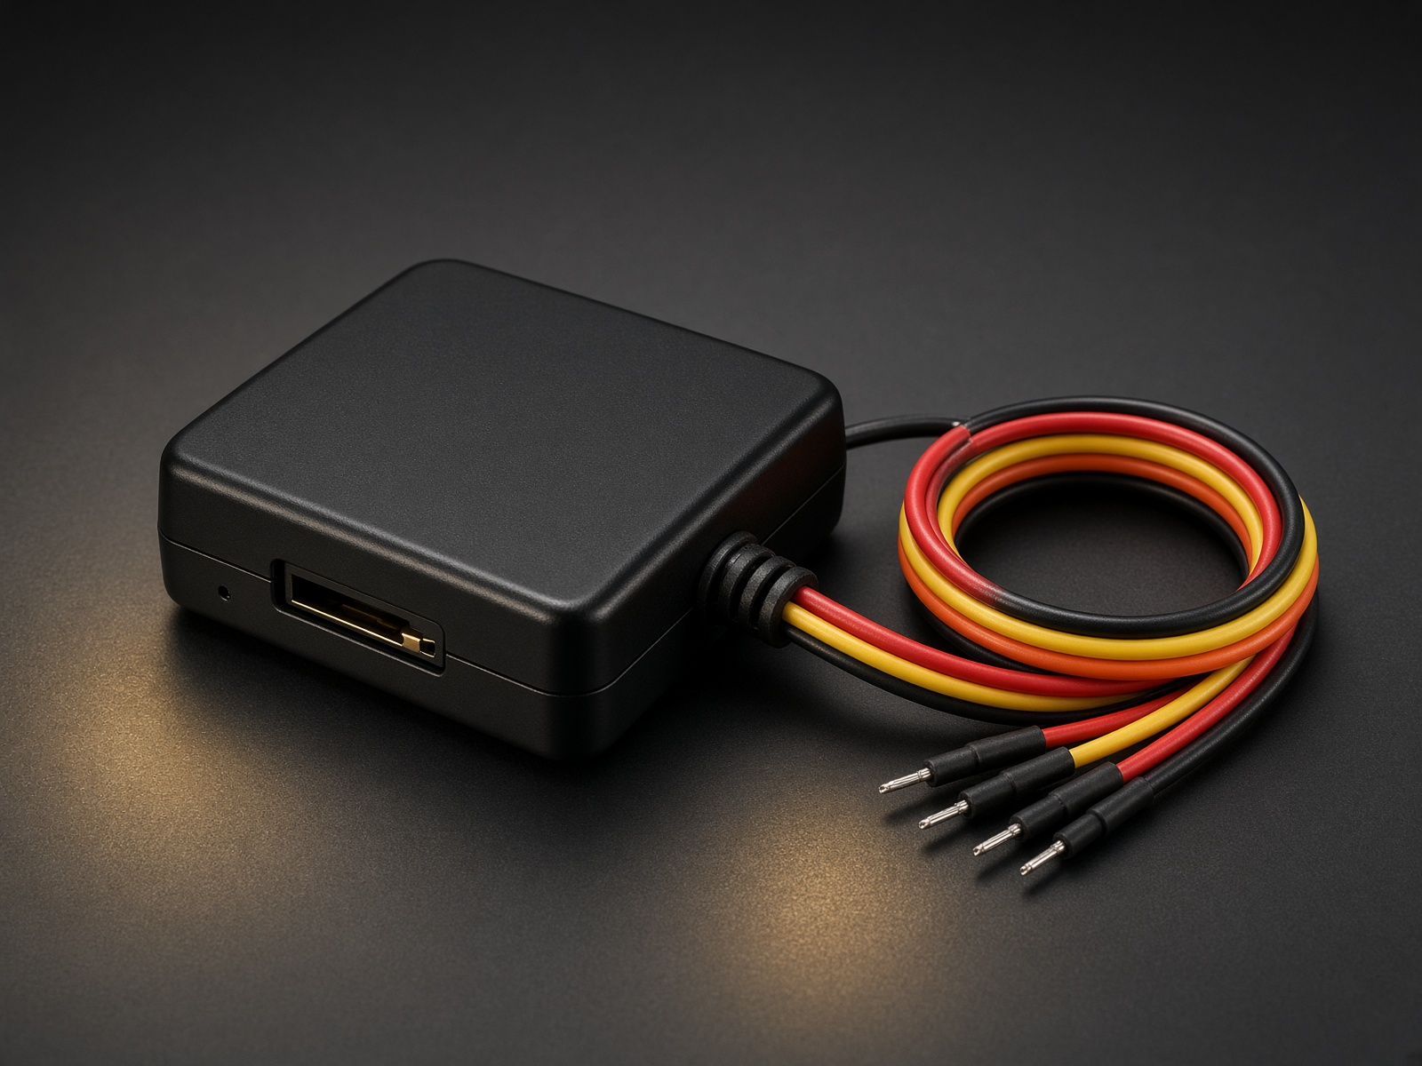
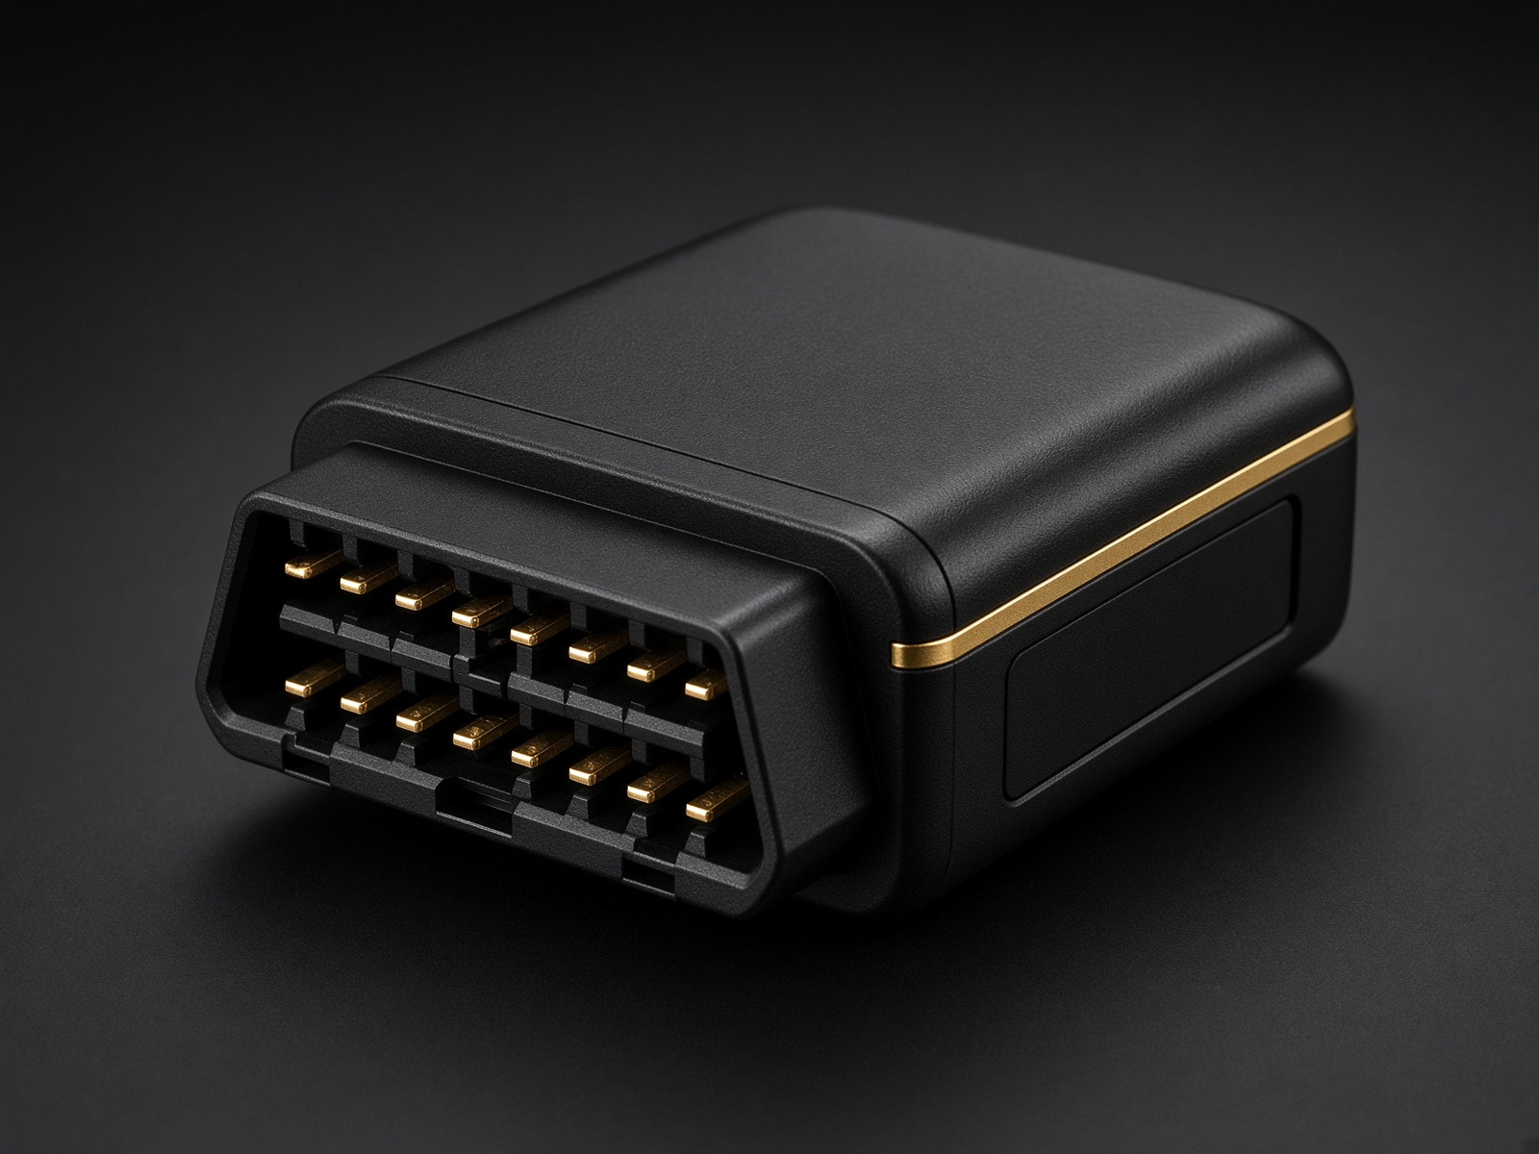
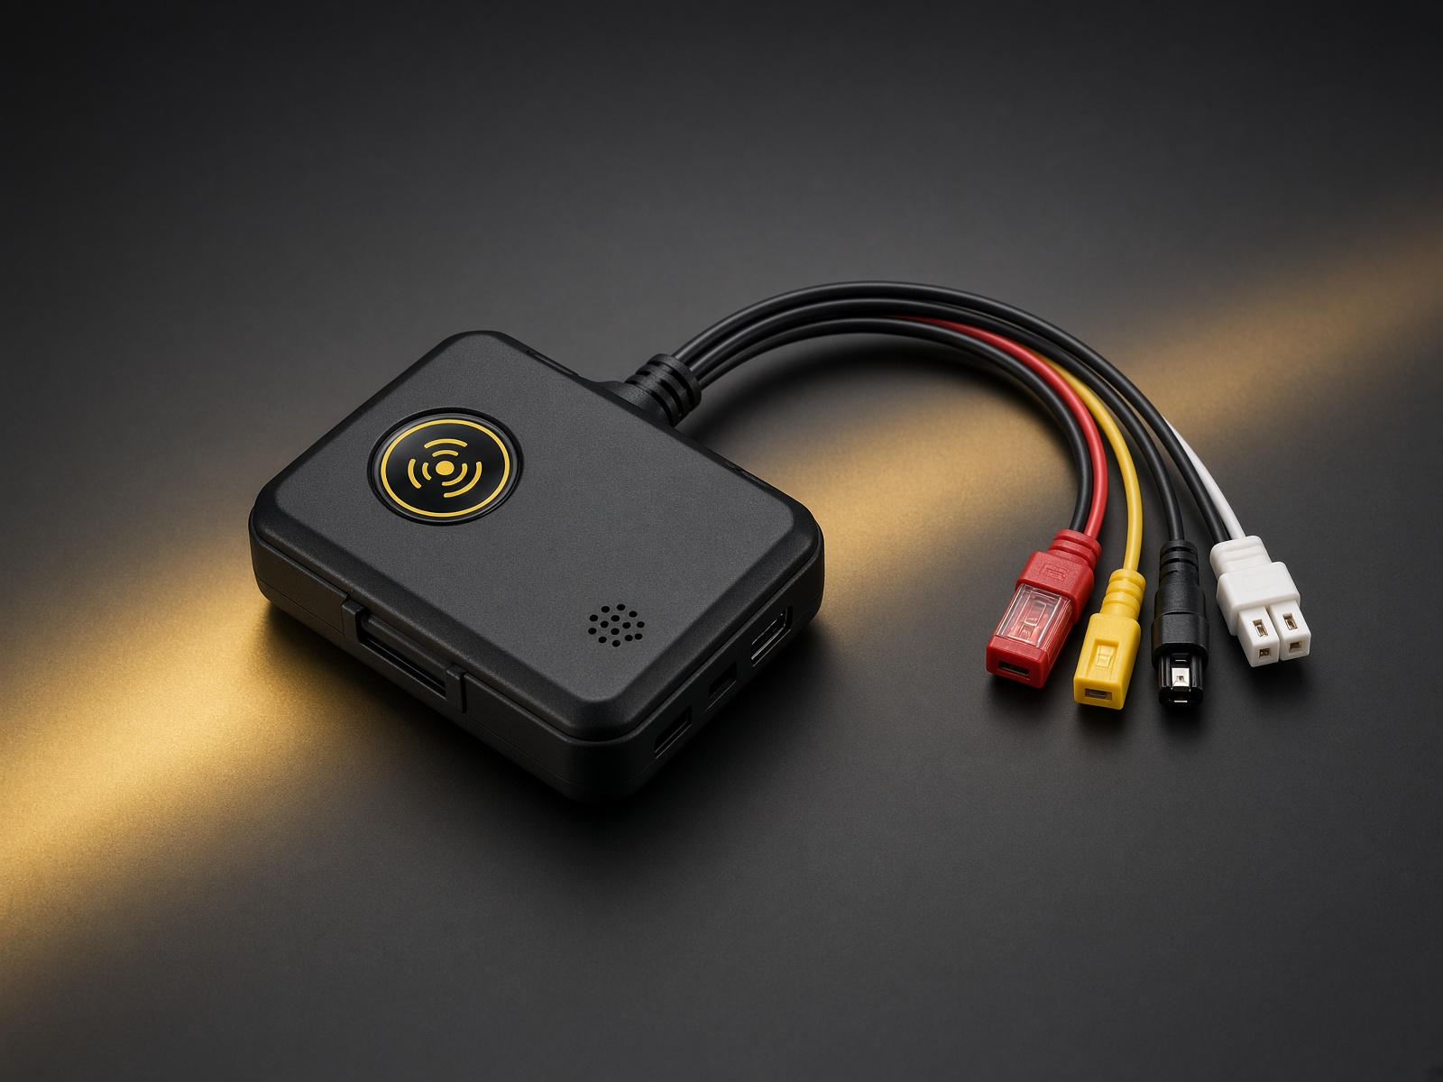
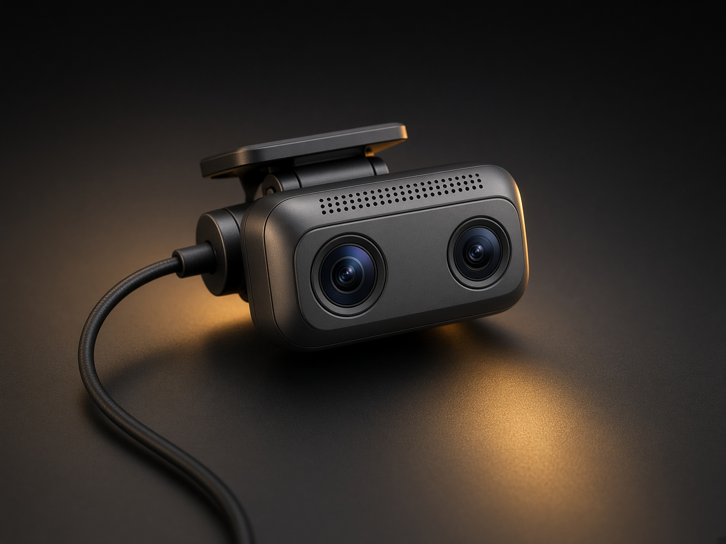
Hardware catalog · prices are reference only
Four boxes. One monitor.
GT06
C50 OBD-II
GT16
TC603 AI cam
1,750,000 LAK
1,950,000 LAK
2,150,000 LAK
4,400,000 LAK
Popular · 3,000 records · mic
Wired ACC + power. EV (wire tap) and fuel. Relay option. Not hidden.
Recommend EV · 3,000 records · no mic
Plug J1962. No cutting. OBD live data. Not hidden.
Enterprise · 8,000 records · mic
Wired + immobilize, SOS, RFID option. Not hidden.
Dual 1080p · DMS + ADAS · mic
Road + cabin. Face, fatigue, collision. Not hidden.
HM · Dorkbouakham · GPS + EV + HM AI Monitor · reference prices in LAK

Slide 6
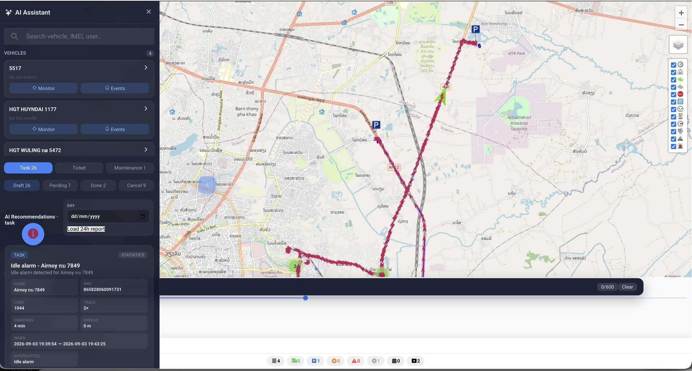
HM AI Monitor + HM Todo
AI watches. The branch decides.
Live GPS and history go to AI. It screens the important events. Managers spare about 90% of staring time. Accept as task, ticket or maintenance on HM Todo.
HM · Dorkbouakham · GPS + EV + HM AI Monitor · reference prices in LAK

Slide 7
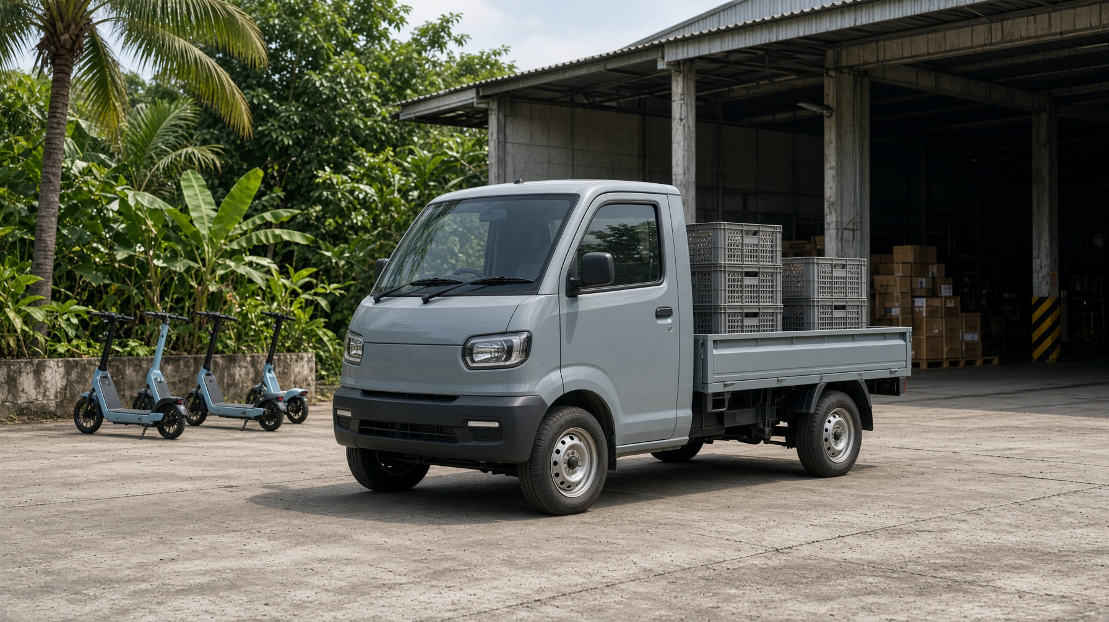
HM EVs
The vehicle can be the tracker.
Ready now: EV motorcycle and low-speed EV transport on HM AI Monitor. Next: our own brand HM — factory GPS, same map. Mini EV, e-ATV, dirt, farm and mini truck — SiaYue factory. 5-year / 50,000 km battery warranty.
HM · Dorkbouakham · GPS + EV + HM AI Monitor · reference prices in LAK

Slide 8
Next
A pilot book. A map. A close-out.
Start with a leasing cohort: pick GT06 or C50 for volume, GT16 for high-value, TC603 where driver behaviour matters. Same HM AI Monitor login for the branch.
Dorkbouakham · Ban Pakthang · trackerla.laoapps.com · 020 5551 632 · 020 7786 8868
HM · Dorkbouakham · GPS + EV + HM AI Monitor · reference prices in LAK

